Slide 1
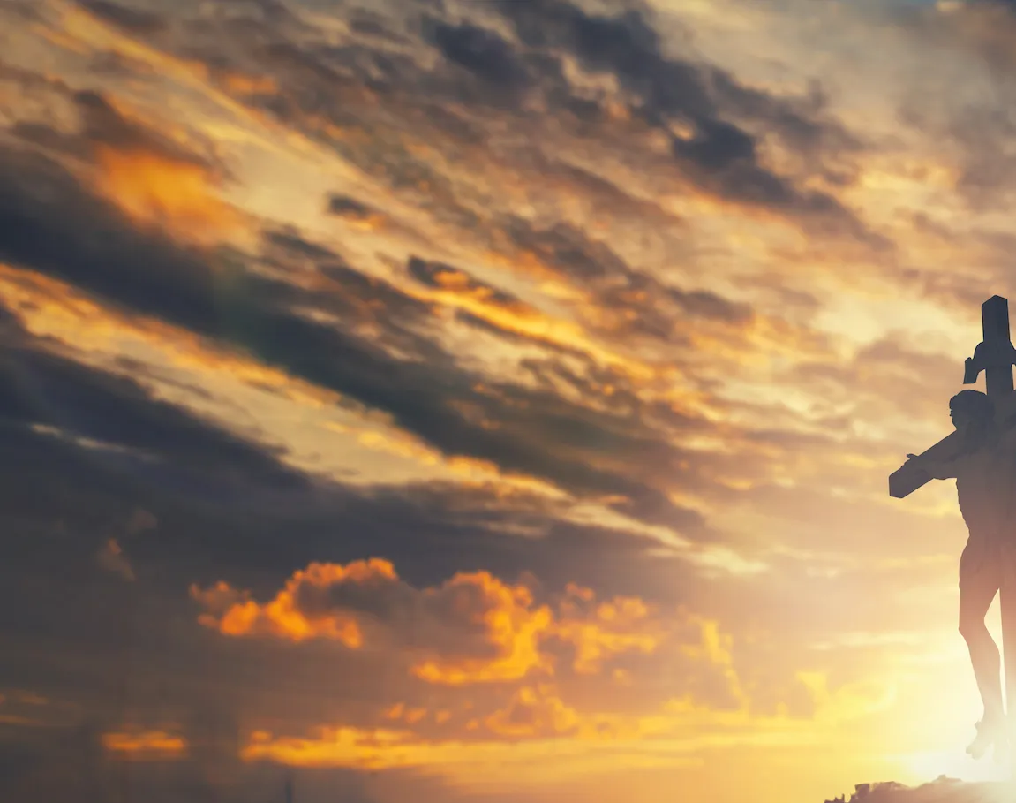
I Stand Amazed in the Presence

Slide 2
G
I stand amazed in the presence
D G
Of Jesus the Nazarene
C G
And wonder how He could love me,
G D G
A sinner, condemned, unclean.

Slide 3
G
How marvelous, How wonderful
D
And my song shall ever be:
G Em
How marvelous, How wonderful
Am G D G
Is my Savior's love for me

Slide 4
G
He took my sins and my sorrows;
D G
He made them His very own
C G
He bore the burden to Calvary,
G D G
And suffered and died alone

Slide 5
G
How marvelous, How wonderful
D
And my song shall ever be:
G Em
How marvelous, How wonderful
Am G D G
Is my Savior's love for me

Slide 6
G
When with the ransomed in glory,
D G
His face I at last shall see
C G
’Twill be my joy through the ages
G D G
To sing of His love for me

Slide 7
G
How marvelous, How wonderful
D
And my song shall ever be:
G Em
How marvelous, How wonderful
Am G D G
Is my Savior's love for me
END

